Slide 1
17th June 2021
ARM11 – Assembler & Emulator
Extension: A Concurrent Application of Blockchain Mining and Exchange in C
Ashvin Arsakularatne
aa9220@ic.ac.uk
Kavya Chopra
kc2320@ic.ac.uk
Siddhant Singh
ss5120@ic.ac.uk
Ye Lun Yang
yly19@ic.ac.uk

Slide 2
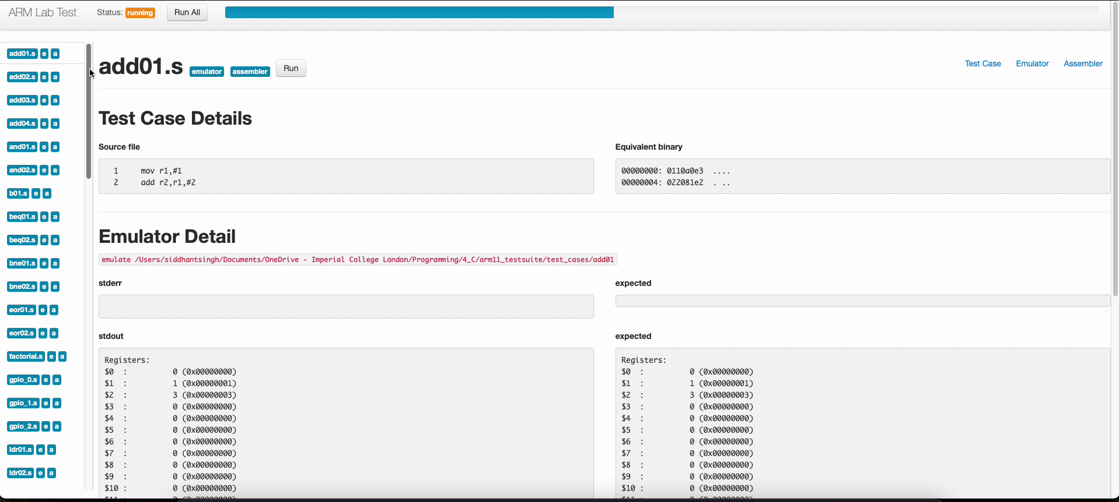
Test Cases (passes all ☺)

Slide 3
EMULATOR

Slide 4
Roadblock (CSPR flags)
Initial design:
Multiple helper functions used to calculate C flag
Discrepancies in types
Issues difficult to detect
How we modified it:
gdb debugging
Local test cases
Repeat until functions work and all test cases pass

Slide 5
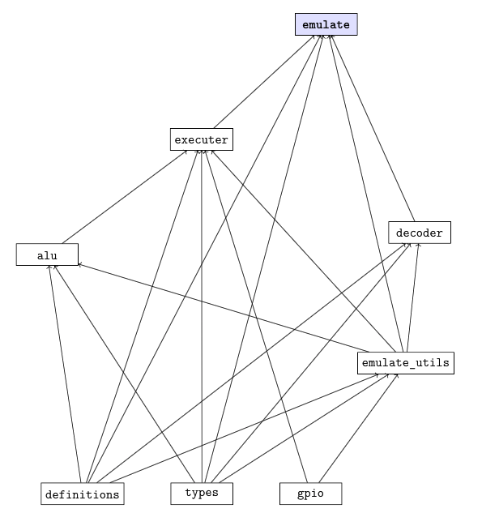
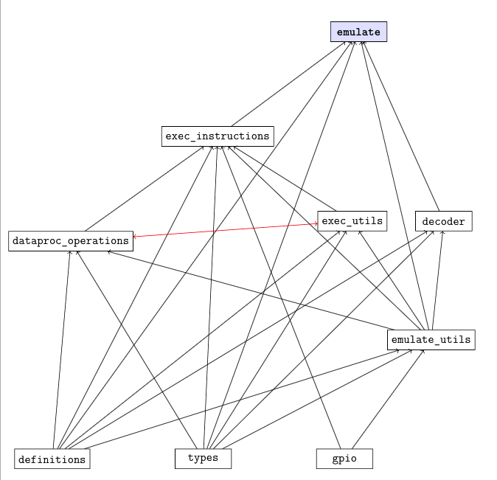
Cyclic File Dependencies

Slide 6
Cyclic File Dependencies
Initial Design:
Nested dependencies
Cyclic dependencies
How we modified it:
Deleted all dependencies from all the header files
Modified the dependencies in the .c files accordingly
Drew graph that mapped out all dependencies between the files
Merged relevant files to remove cyclic dependencies

Slide 7
ASSEMBLER

Slide 8
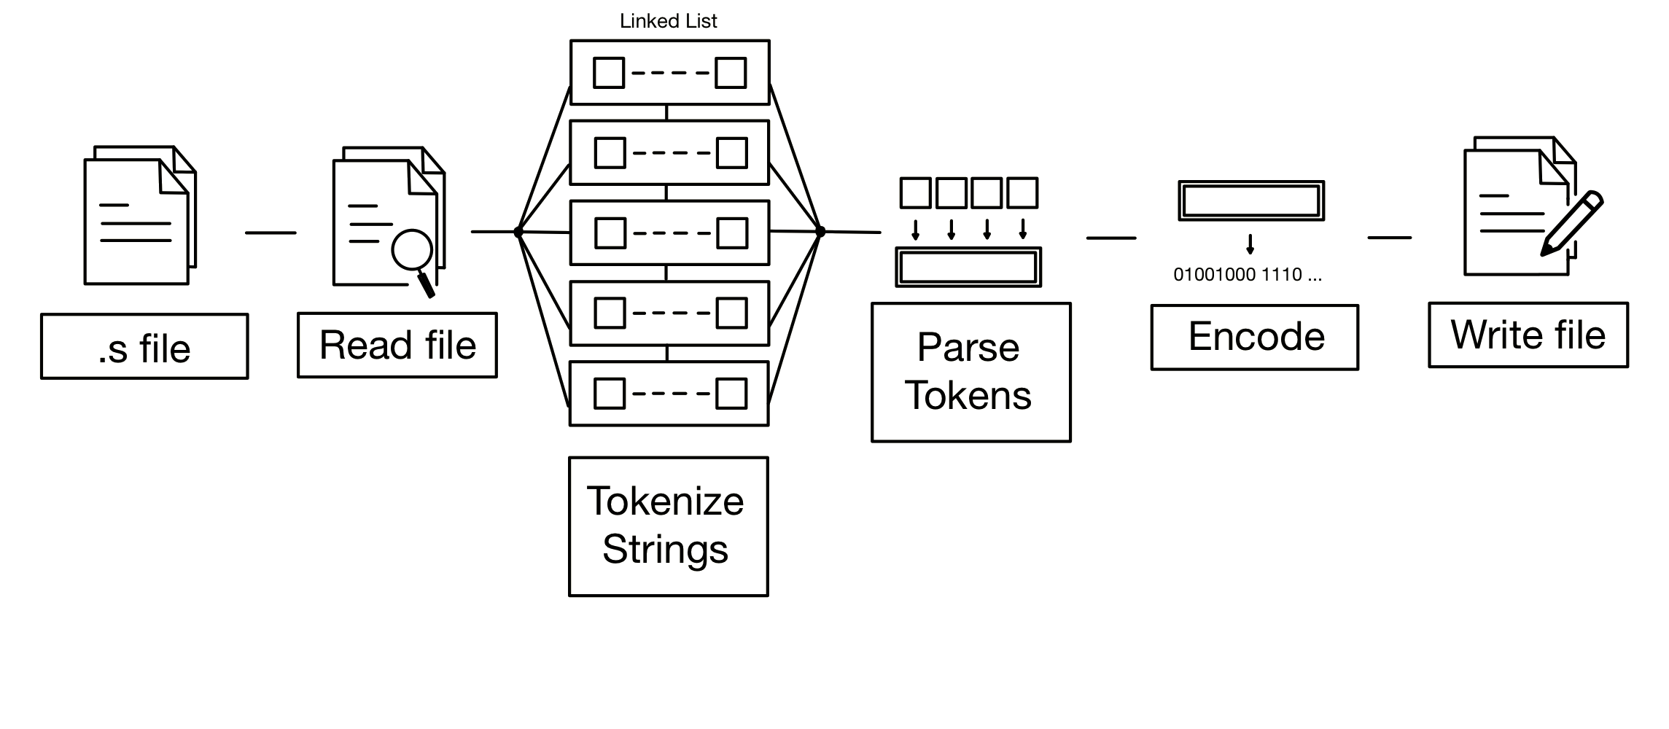
General Structure

Slide 9
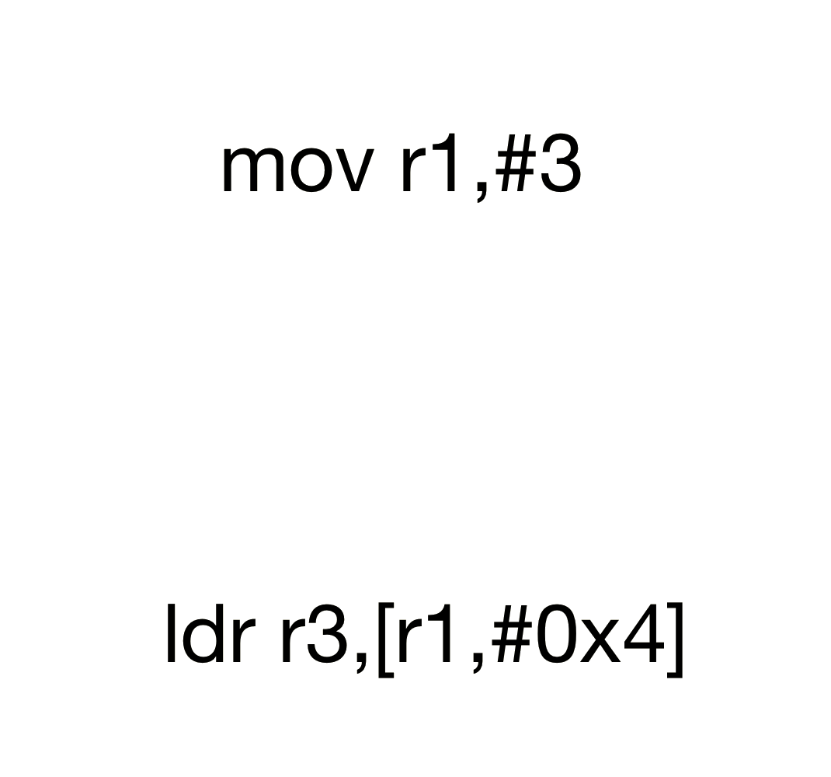
Tokenizer

Slide 10
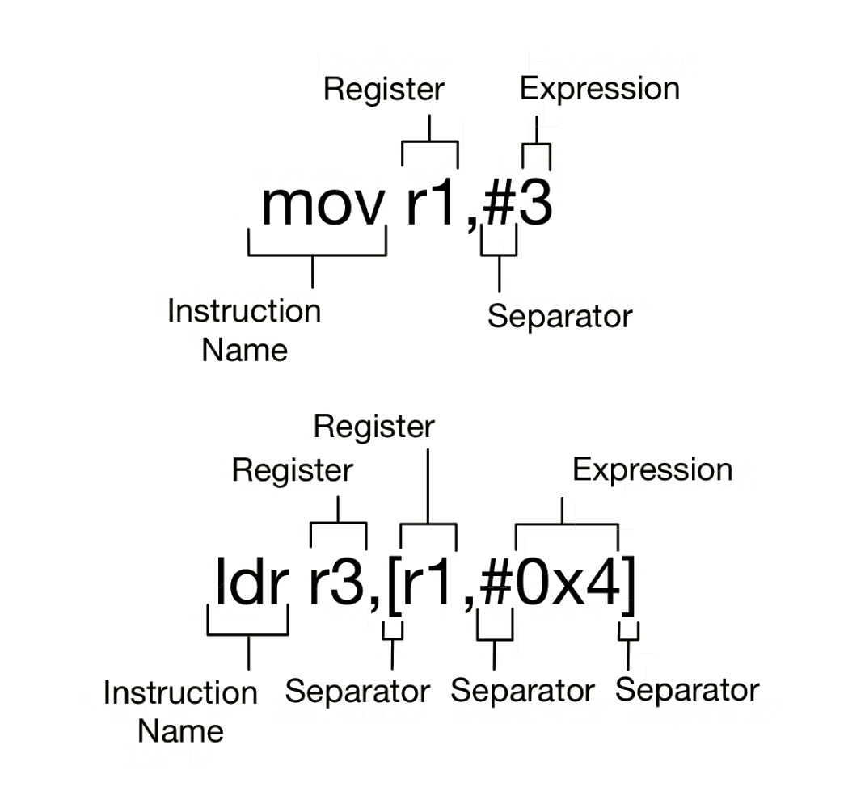
Tokenizer

Slide 11
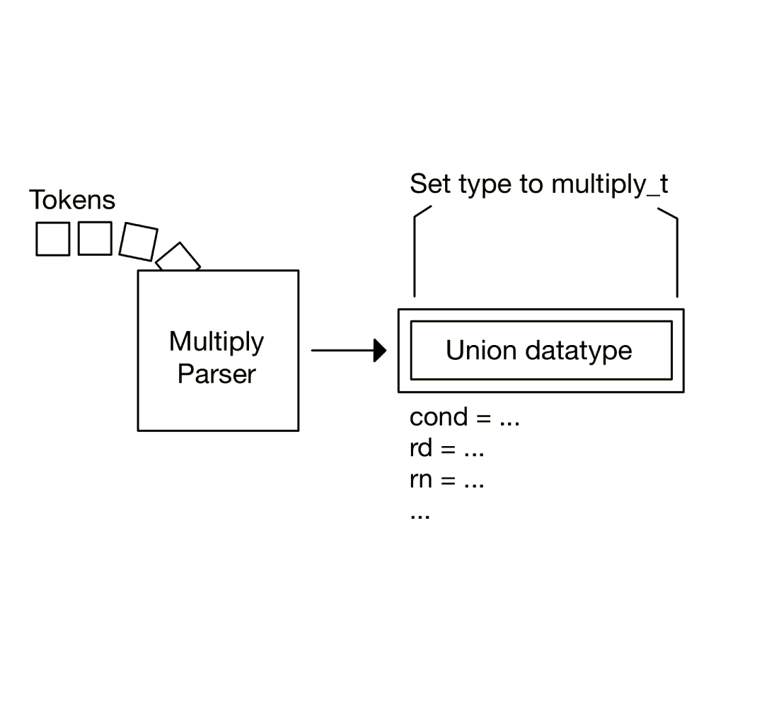
Parser

Slide 12
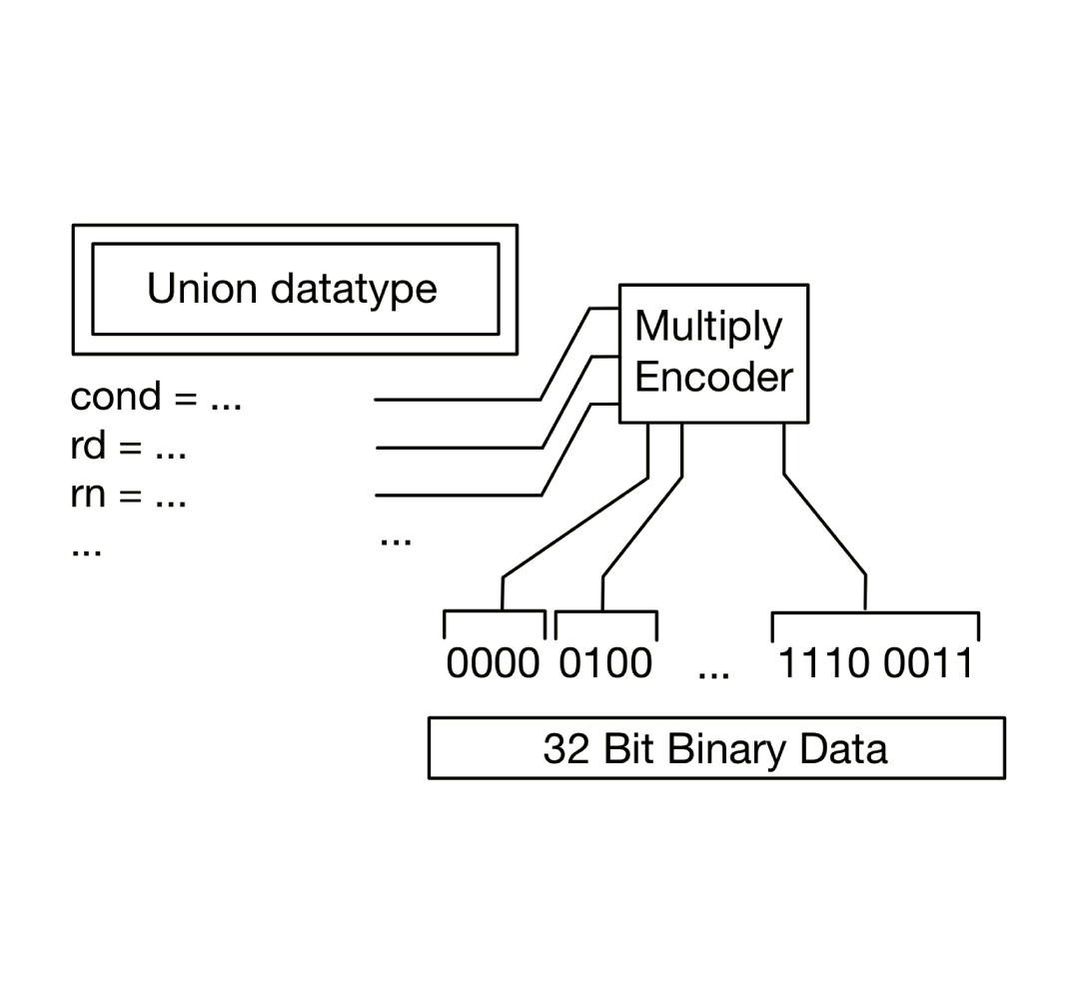
Encoder

Slide 13
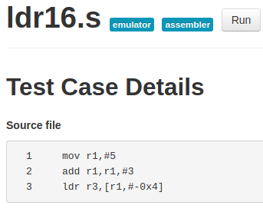
Interesting Test Cases
ldr16.s
Separators #, -

Slide 14
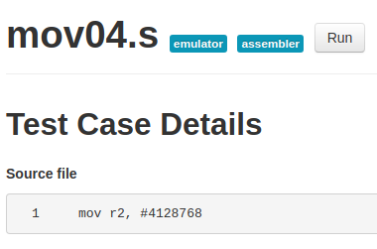
Interesting Test Cases
mov04.s
Special op2

Slide 15
Roadblock (parse_operand2())
Many cases
Difficult optimal implementation

Slide 16
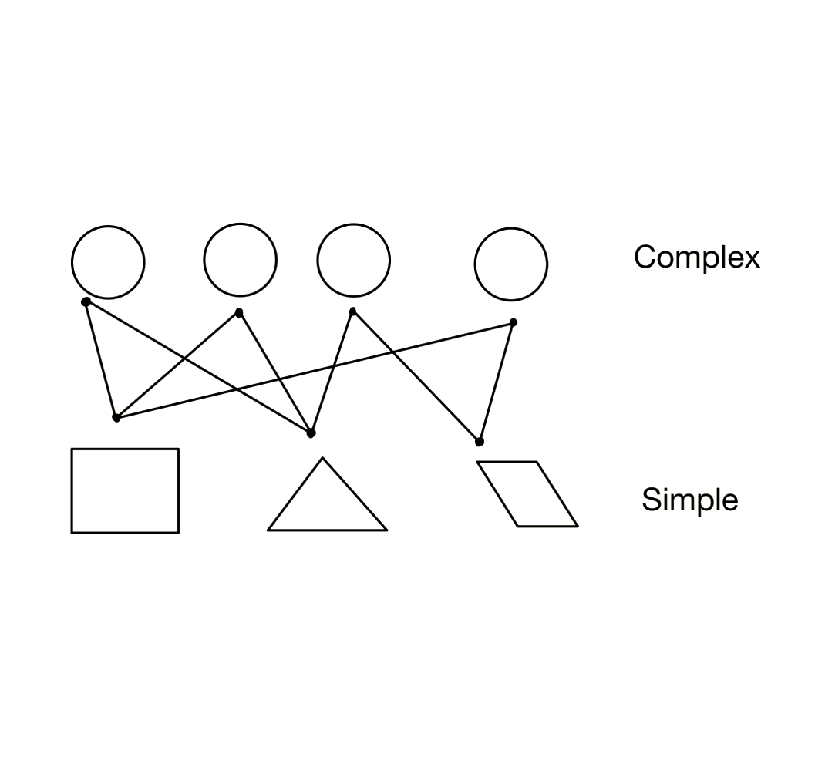
Roadblock (parse_operand2())

Slide 17
REFLECTION

Slide 18

Overall Group Work
Used Discord for communication throughout the project.
Different time zones were massive advantages.
ICL

Slide 19
Programming with Peers
Things we learned:
Distinguish between work and leisure hours.
Crucial to create a safe environment for everyone to work in.
Constructive criticism is key !
Opposing ideas are encouraged !!

Slide 20

Things to do differently
Create a more regimented project schedule (use apps like Notion or Evernote).
Spend some more time planning.
Adhere to language conventions from the start of the project.
Do the project in person ☺ !

Slide 21

Practices to continue: Pair Programming
Driver: The person typing the code
Observer: The person reviewing everything the driver types.

Slide 22
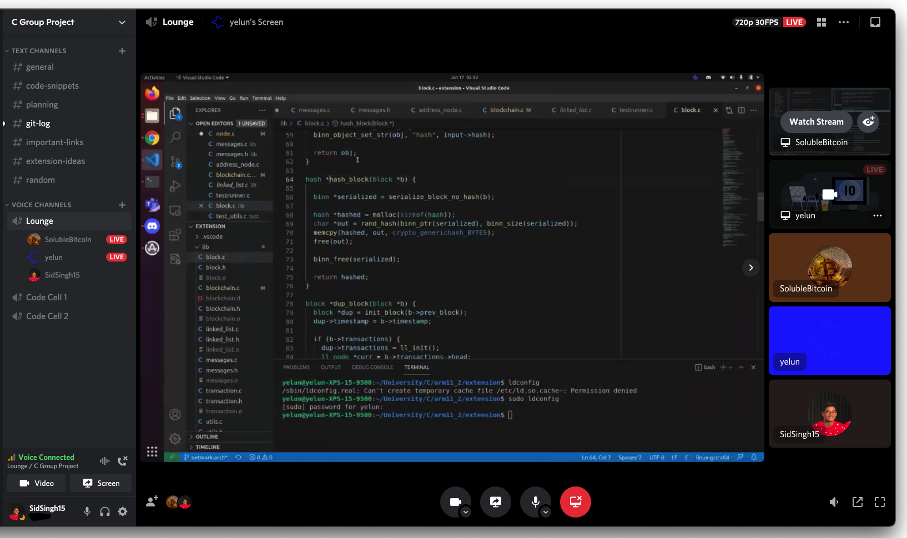

Slide 23

Practices to continue: Meaningful Git Messages¹
chore: magic number fixes in `parser.c`
Type | Summary
feat | New feature
fix | Bug fix
docs | Documentation change
style | Formatting
refactor | Refactoring
test | Adding tests
chore | Grunt work
1: https://gist.github.com/joshbuchea/6f47e86d2510bce28f8e7f42ae84c716

Slide 24
THANK YOU

